Slide 1
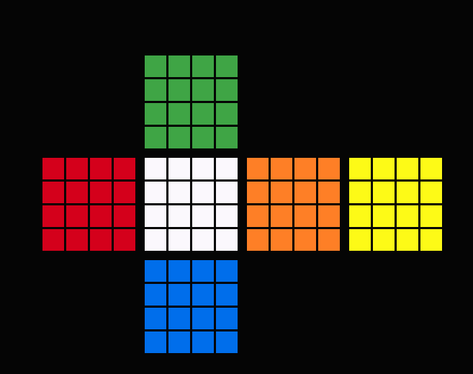
Y3
Back
0
0
0
0
0
1
2
3
X2
1
1
1
1
0
1
2
3
2
2
2
2
0
1
2
3
3
3
3
3
0
1
2
3
X2
0
0
0
0
0
0
0
0
0
0
0
0
0
0
0
0
0
1
2
3
0
1
2
3
0
1
2
3
0
1
2
3
Z2
1
1
1
1
1
1
1
1
1
1
1
1
1
1
1
1
0
1
2
3
0
1
2
3
0
1
2
3
0
1
2
3
2
2
2
2
2
2
2
2
2
2
2
2
2
2
2
2
Left
0
1
2
3
0
1
2
3
0
1
2
3
0
1
2
3
3
3
3
3
3
3
3
3
3
3
3
3
3
3
3
3
0
1
2
3
0
1
2
3
0
1
2
3
0
1
2
3
X2
Right
Y3
0
0
0
0
Down
0
1
2
3
1
1
1
1
0
1
2
3
2
2
2
2
X2
0
1
2
3
3
3
3
3
0
1
2
3
Front

